Slide 1
A-China MCU007 puf
What is Physical Unclonable Function

Slide 2
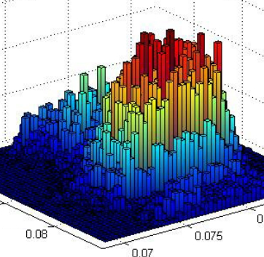
What is Physical Unclonable Function?
PUF are a technique in physical object that inherent properties variations produces these instance-specific measurements
e.g. Human Finger Print
Data Extraction

Slide 3
What is MCU007 PUF
MCU007’s PUF is a special circuit designed utilize variation of silicon processing techniques to generate RANDOM NUMBER
Competing Oxide Rupture Technology
Utilize imperfection silicon, imperfection semiconductor manufacturing process
Bit error rate toward to zero

Slide 4
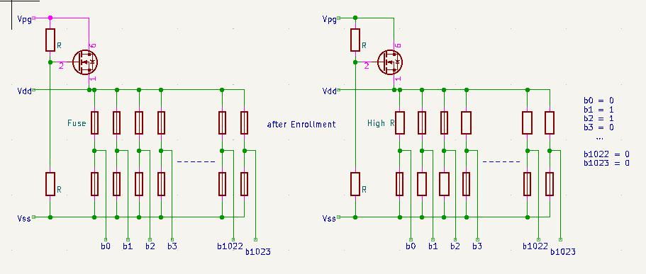
MCU007 PUF Design Concept

Slide 5
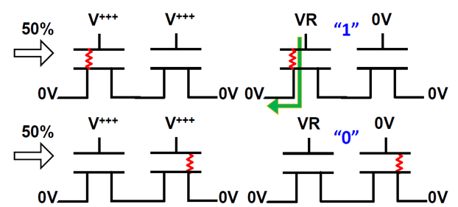
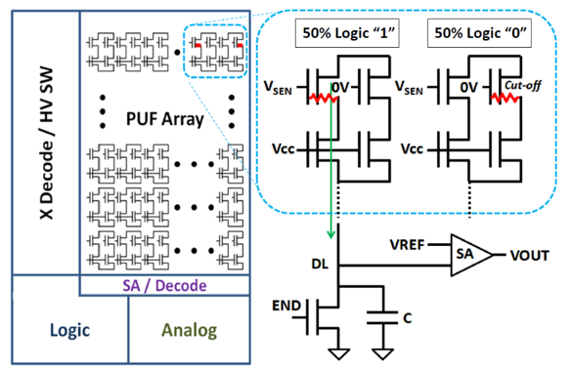
MCU007 PUF Technology Competition Oxide Rupture Technology

Slide 6
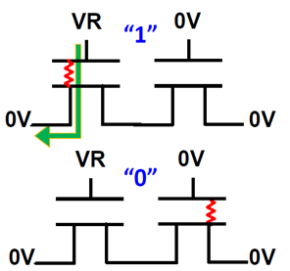
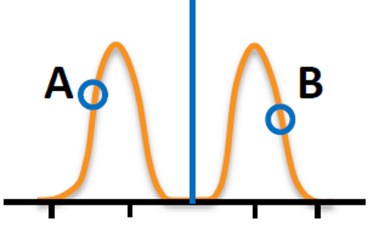
PUF Randomness
Sense Current
50%
Current Sensing
50%
Bit error rate self approaching Zero
ECC not necessary

Slide 7
Where to use
Device Identity
Root of Trust
Seed for Key Generation
Firmware Protection
Establish two parties Communication Common Key
Secure Communication Packets

Slide 8
Typical Applications
Device Identity, Internet Of Thing (IoT)
Communication Channel Key Generator
Seed for Keys Generation
Firmware Protection
Authentication

Slide 9
Summary of MCU007’s PUF
Innovative Technology
Intrinsic Property - unpredictable, unclonable
Truly Random and Robust
Self Enrolment - High Reliability
Bit Error Rate approaching zero, ECC support not necessary
Hamming Weight approaching 50%
Secure – MCU with PUF support

Slide 10
Thank you

